Slide 1
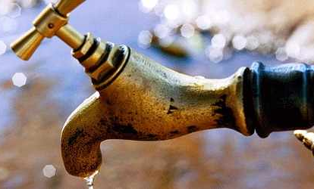
«Water Sector Reform in Kenya »
Trainings 24.-28.8. and 28.9.-2.10.2015

Slide 2
New Urban Sanitation Technologies
Based on „New Urban Sanitation Technologies“ e-learning course of Margraf Publishers

Slide 3
Table of Content
What is wastewater
Functional groups
User Interface
Collection and Storage/Treatment
Conveyance
(Semi-) Centralized treatment
Use and/or Disposal
System templates

Slide 4
Sanitation systems, a systematic view
We define sanitation as a multi-step process in which human excreta and wastewater are managed from the point of generation to the point of use or ultimate disposal.
A Sanitation System is a context-specific series of technologies and services for the management of these wastes (or resources), i.e., for their collection, containment, transport, transformation, utilization or disposal.
A sanitation system is comprised of Products (wastes) that travel through Functional Groups which contain Technologies that can be selected according to the context.
U
S
C
T
D

Slide 5
U
S
C
T
D
User Interface
Collection/Storage
Conveyance
Treatment
Disposal / Re-use
Sanitation Value Chain
Notes:
A sanitation system is comprised of Products (wastes) that travel through Functional Groups which contain Technologies that can be selected according to the context.

Slide 6
Functional Groups
A Functional Group is a grouping of technologies which perform a similar function.
There are five (5) different Functional Groups from which the technologies used to build a system are chosen.
The five (5) Functional Groups are:
User Interface (Technologies U1–U6): Red
Collection and Storage/Treatment (Technologies (S1–S12): Yellow
Conveyance (Technologies C1–C7): Orange
(Semi-) Centralized Treatment (Technologies T1–T17): Green
Use and/or Disposal (Technologies D1–D12): Blue

Slide 7
Functional Groups
U
S
C
T
D
User Interface
Collection/Storage/(T)
Conveyance
Treatment
Disposal / Re-use
U1 to U6
Technologies with which the user interacts
S1 to S12 Technologies that collect and store the products generated
C1 to C7 describes the transport of products from one FG to another
T1 to T17 treatment technologies appropriate for large user groups)
D1 to D13 Different technologies, products are returned to the environment

Slide 8
User Interface
User Interface (U) describes the type of toilet, pedestal, pan, or urinal with which the user comes in contact; it is the way by which the user accesses the sanitation system.
In many cases, the choice of User Interface will depend on the availability of water. Note that Greywater and Stormwater do not originate at the User Interface, but may be treated along with the products that originate from it.

Slide 9
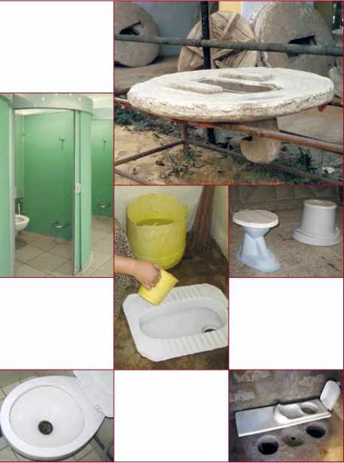
User Interface

Slide 10
User Interface
is the way in which the sanitation system is accessed:
U.01: Dry Toilet
U.02: Urine-Diverting Dry Toilet (UDDT)
U.03: Urinal
U.04: Pour Flush Toilet
U.05: Cistern Flush Toilet
U.06: Urine-Diverting Flush Toilet (UDFT)

Slide 11
Collection and Storage/Treatment (S)
Collection and Storage/Treatment (S) describes the ways of collecting, storing, and sometimes treating the products generated at the User Interface.
The treatment provided by these technologies is often a function of storage and is usually passive (e.g., requiring no energy input).
Thus, products that are ‘treated’ by these technologies often require subsequent treatment before Use and/or Disposal.

Slide 12
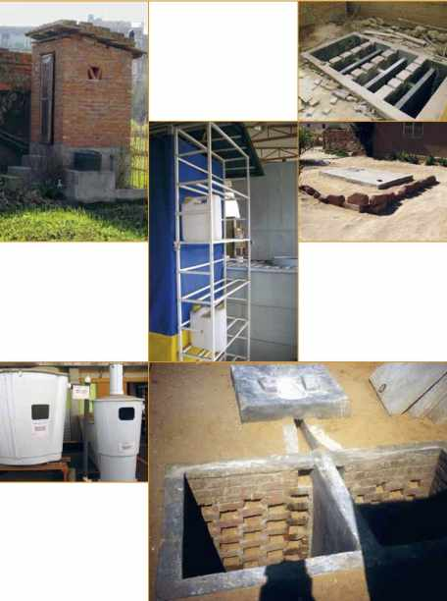
Collection and
Storage/Treatment (S)

Slide 13
Collection and Storage/Treatment (S)
describes the technologies that collect and store the products generated at the User Interface:
S.01: Urine Storage Tank/Container
S.02: Single Pit
S.03: Single Ventilated Improved Pit (VIP)
S.04: Double Ventilated Improved Pit (VIP)
S.05: Fossa Alterna
S.06: Twin Pits for Pour Flush
S.07: Dehydration Vaults
S.08: Composting Chamber
S.09: Septic Tank
S.10: Anaerobic Baffled Reactor (ABR)
S.11: Anaerobic Filter
S.12: Biogas Reactor

Slide 14
Conveyance (C)
Conveyance (C) describes the transport of products from one functional group to another.
Although products may need to be transferred in various ways between functional groups, the longest, and most important gap is between User Interface or Collection and Storage/Treatment and (Semi-) Centralized Treatment.
Therefore, for the sake of simplicity, Conveyance only describes the technologies used to transport products between these functional groups.

Slide 15
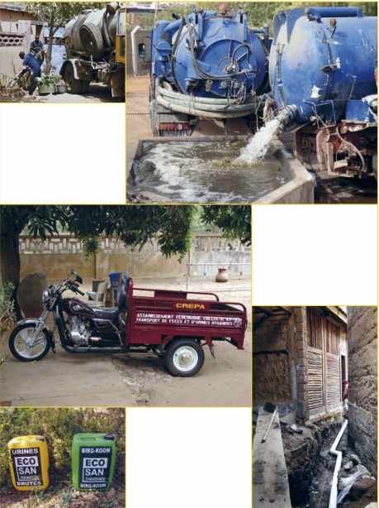
Conveyance (C)

Slide 16
Conveyance (C)
C.01: Jerrycan/Tank
C.02: Human-Powered Emptying and Transport
C.03: Motorized Emptying and Transport
C.04: Simplified Sewer
C.05: Solids-Free Sewer
C.06: Conventional Gravity Sewer
C.07: Transfer Station (Underground Holding Tank)

Slide 17
(Semi-) Centralized Treatment
(Semi-) Centralized Treatment (T) refers to treatment technologies that are generally appropriate for large user groups (i.e., neighbourhood to city level applications).
The operation, maintenance, and energy requirements of technologies within this functional group are generally higher than for smaller-scale technologies at the S level. The technologies are divided into 2 groups:
T.1-T.12 are primarily for the treatment of Blackwater, Brownwater, Greywater or Effluent, whereas
T.13-T.17 are mainly for the treatment of Sludge.

Slide 18
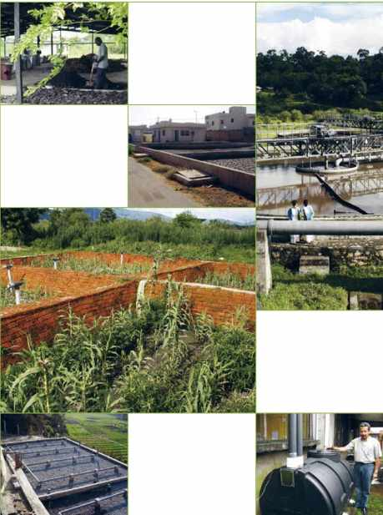
(Semi-) Centralized
Treatment

Slide 19
(Semi-) Centralized Treatment,
the treatment technologies generally appropriate for larger groups:
Here the Technologies for the treatment of Blackwater, Brownwater, Greywater or Effluent:
T.01: Settler
T.02: Imhoff Tank
T.03: Anaerobic Baffled Reactor (ABR)
T.04: Anaerobic Filter
T.05: Waste Stabilization Ponds (WSP)
T.06: Aerated Pond
T.07: Free-Water Surface Constructed Wetland
T.08: Horizontal Subsurface Flow Constructed Wetland
T.09: Vertical Flow Constructed Wetland
T.10: Trickling Filter
T.11: Upflow Anaerobic Sludge Blanket Reactor (UASB)
T.12: Activated Sludge

Slide 20
(Semi-) Centralized Treatment,
the treatment technologies generally appropriate for larger groups:
Here the Technologies for the treatment of sludge:
T.13: Sedimentation/Thickening Ponds
T.14: Unplanted Drying Beds
T.15: Planted Drying Beds
T.16: Co-Composting
T.17: Biogas Reactor

Slide 21
Use and/or Disposal
Use and/or Disposal (D) refers to the methods by which products are ultimately returned to the environment,
either as useful resources or reduced-risk materials.
Furthermore, products can also be cycled back into a system (e.g., by using treated Greywater for flushing).

Slide 22
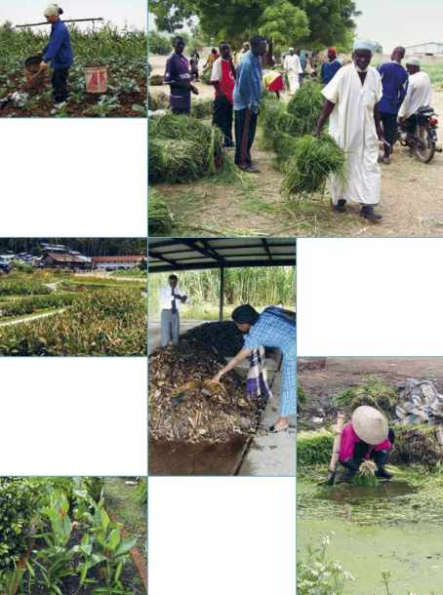
Use and/or Disposal

Slide 23
Use and/or Disposal
refers to the methods by which products are ultimately returned to the environment:
D.01: Fill and Cover/Arborloo
D.02: Application of Stored Urine
D.03: Application of Dehydrated Faeces
D.04: Application of Pit Humus and Compost
D.05: Application of Sludge
D.06: Irrigation
D.07: Soak Pit
D.08: Leach Field
D.09: Fish Pond
D.10: Floating Plant Pond
D.11: Water Disposal/Groundwater Recharge
D.12: Surface Disposal and Storage
D.13: Biogas Combustion

Slide 24
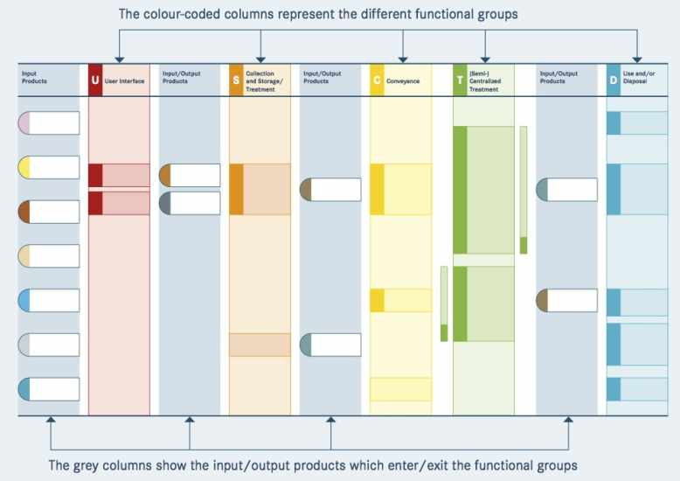
Different columns of a system template

Slide 25
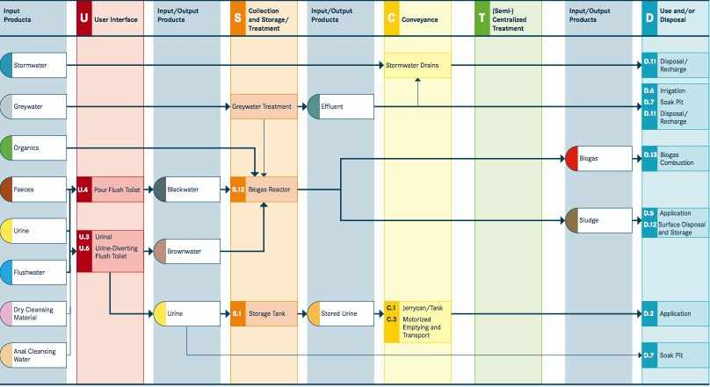
Biogas System as an example

